Slide 1


CyberSpace DataWarehouse & Analytics
CyberCloud
CyberSpace
CyberPay
DataWarehousing & Analytics
CyberSpaceLTE
The Data Warehouse (DW) is the storage system that connects and harmonizes large amounts of data from many different sources. Its purpose is to feed business intelligence (BI), reporting, and analytics, and support regulatory requirements – so the company can turn their data into insight and make smart, data-driven decisions.
The Data warehouse stores current and historical data in one place and act as the single source of truth for the organization.

Slide 2








Data Warehouse Architecture (Overview)
Source Systems
Reports
and Visualization
OLAP Cube / Model
CyberSpaceLTE
Staging Area
Data Warehouse
ETL
ETL
Modelling
CyberCloud
Data Marts
CyberPay

Slide 3













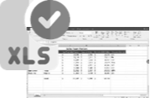




Staging
PRESENTATION
(BUSINESS INTELLIGENCE)
DATA SOURCES
DATA STORAGE & INTEGRATION
Operational Reporting
Dashboards
CyberCloud
OLAP
Reports
ETL
CyberPay
Operational Data Store (Staging)
Data Warehouse
Data Mart
VIEWS
Mobile BI
CyberSpaceLTE
Spreadsheet (Self-service)
METADATA, SECURITY

Slide 4












DATAWAREHOUSE ARCHITECTURE (On-Premise)
Data Sources
Data Ingestion
Staging
Transformation
Data Marts & Data Modeling
Reporting
Modeling
OLAP (SQL Analysis Service)
CyberCloud
Data Marts
Power BI (On-Premise Report Server)
Staging
CyberPay
Orchestration
Transformation
SQL Database (Enterprise Data warehouse)
SSIS (Data Pipelines / Package)
Scheduling
CyberSpaceLTE
SQL Server Agent
SQL Server Management Studio (DBMS, Qerying, etc.)

Slide 5


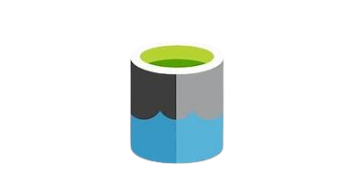

DATAWAREHOUSE ARCHITECTURE (Cloud)
Data Sources
Data Ingestion
Staging
Transformation
Data Marts & Data Modeling
Reporting
Modeling
Power BI Model
CyberCloud
Power BI Cloud
Microsoft Integration Runtime (Gateway)
Staging
Data Marts
CyberPay
Transformation
SQL Database (Enterprise Data warehouse)
Azure Data Lake Storage Gen 2
CyberSpaceLTE
Orchestration
Azure Data Factory (Data Pipelines)
Scheduling

Slide 6
DATAWAREHOUSE SCHEMA STRUCTURE (SNOWFLAKE SCHEMA)
DIMENSION
DIMENSION
DIMENSION
DIMENSION
DIMENSION
FACT
DIMENSION
DIMENSION
DIMENSION

Slide 7
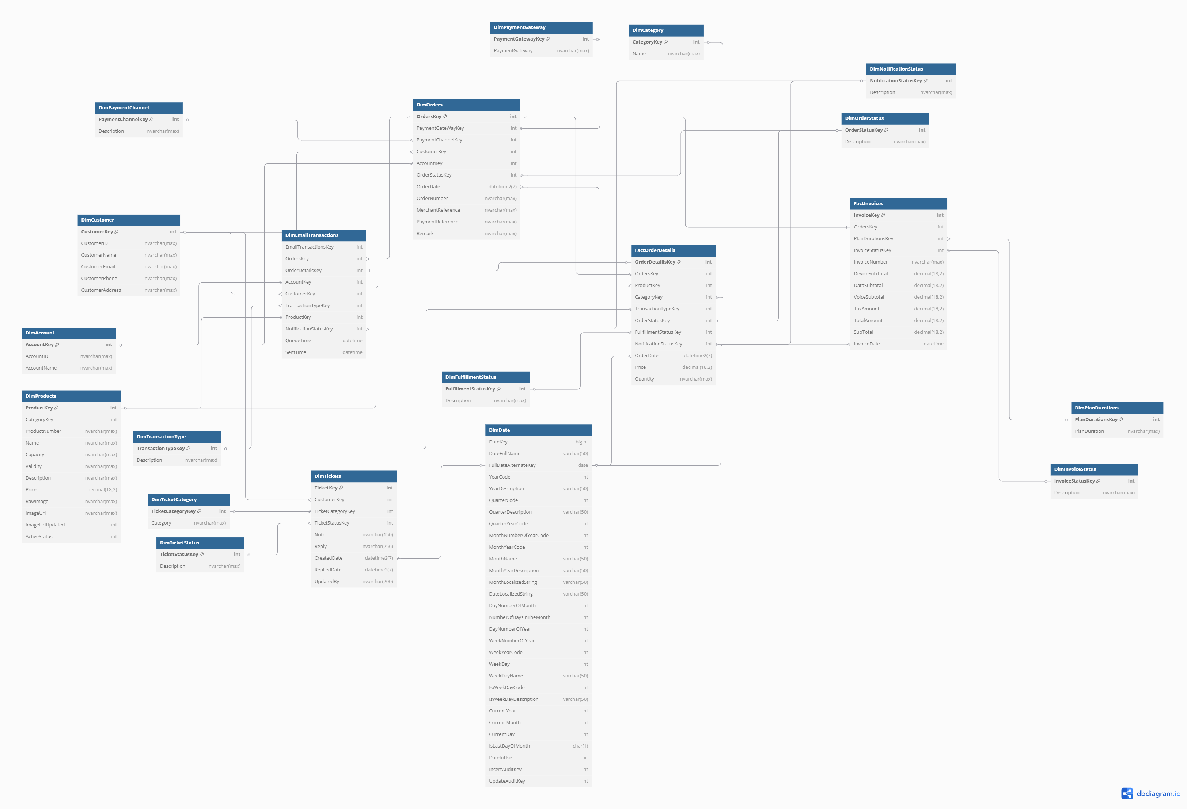
CyberSpaceLTE E-R Diagram
Click here to view

Slide 8



Thanks!
You can find us at:
cyberspace.net.ng
cybsoft@cyberspace.net.ng

